Slide 1
SDLC
SOFTWARE DEVELOPMENT LIFE CYCLE

Slide 2
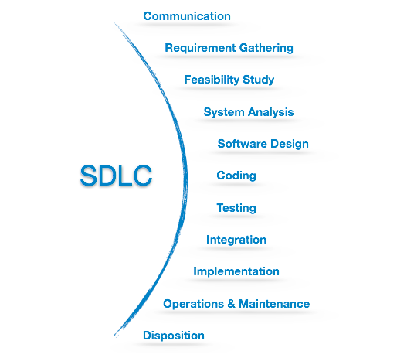
Software Development Life Cycle, SDLC for short, is a well-defined, structured sequence of stages in software engineering to develop the intended software product.
SDLC provides a series of steps to be followed to design and develop a software product efficiently. SDLC framework includes the following steps:

Slide 3
Communication
This is the first step where the user initiates the request for a desired software product.
contacts the service provider and tries to negotiate the terms.
submits his request to the service providing organization in writing
Requirement Gathering
studying the existing or obsolete system and software,
conducting interviews of users and developers,
referring to the database or
collecting answers from the questionnaires.

Slide 4
Feasibility Study
Team analyzes if a software can be made to fulfill all requirements of the user
If the project is financially, practically and technologically feasible for the organization to take up.
Many Algorithms available, which help the developers to conclude the feasibility of a software project.
System Analysis
Understanding of software product limitations, learning system related problems or changes to be done in existing systems beforehand, identifying and addressing the impact of project on organization and personnel etc.
The project team analyzes the scope of the project and plans the schedule and resources accordingly.

Slide 5
Software Design
The inputs from users and information gathered in requirement gathering phase are the inputs of this step.
The output of this step comes in the form of two designs; logical design and physical design.
Engineers produce meta-data and data dictionaries, logical diagrams, data-flow diagrams and in some cases pseudo codes.
Coding
This step is also known as programming phase. The implementation of software design starts in terms of writing program code in the suitable programming language and developing error-free executable programs efficiently.

Slide 6
Testing
Errors may ruin the software from critical level to its own removal.
Software testing is done while coding by the developers and thorough testing is conducted by testing experts at various levels of code such as module testing, program testing, product testing, in-house testing and testing the product at user’s end.
Integration
Software may need to be integrated with the libraries, databases and other program(s). This stage of SDLC is involved in the integration of software with outer world entities.
Implementation
This means installing the software on user machines. At times, software needs post-installation configurations at user end. Software is tested for portability and adaptability and integration related issues are solved during implementation.

Slide 7
Operation and Maintenance
The software is maintained timely by updating the code according to the changes taking place in user end environment or technology.
This phase may face challenges from hidden bugs and real-world unidentified problems.
Disposition
This phase includes archiving data and required software components, closing down the system, planning disposition activity and terminating system at appropriate end-of-system time.

